Slide 1


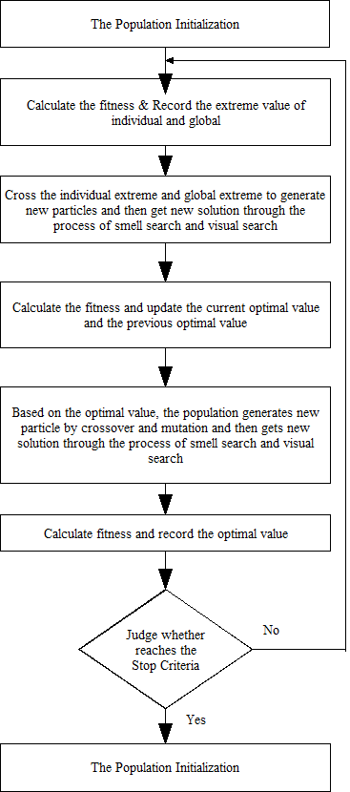
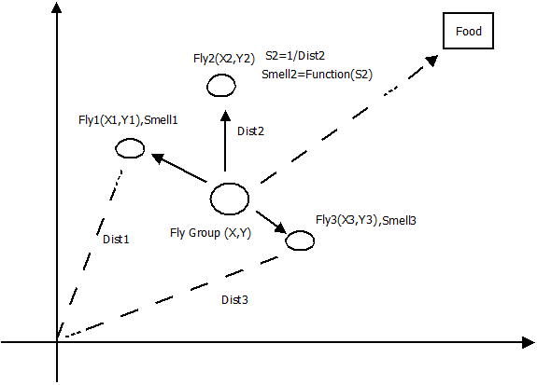
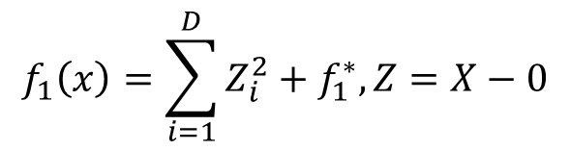
Performance Evaluation of Fruit Fly Optimization Algorithm on classical test problem set
Main Area :- Soft Computing
Sub Area :- Optimization
OBJECTIVE
FFOA on classical test problem set
FFOA
To implement FFOA to the classical test problem sets (CEC2013 or CEC2015).
To check the analysis of result of classical test problem.
To apply FFOA for engineering optimization problem.
DATASET
Dataset published by IEEE Congress on Evolutionary Congress on Evolutionary Computation (CEC)
CEC 2013 :- Dataset published in 2013 including 28 functions.
CEC 2015 :- Dataset published in 2015 including 15 functions.
Summary of CEC’13 expensive optimization test problems
Fig : Structure of FFOA
Example
Categories | No | Functions | Related basic functions | F_{i} *
Unimodal | 1 | Rotated Bent Cigar Function | Bent Cigar Function | 100
functions | 2 | Rotated Discus Function | Discus Function | 200
Simple | 3 | Shifted and Rotated Weierstrass Function | Weierstrass Function | 300
Multimodal | 4 | Shifted and Rotated Schwefel’s Function | Schwefel’s Function | 400
functions
 | 5 | Shifted and Rotated Katsuura Function | Katsuura Function | 500
 | 6 | Shifted and Rotated HappyCat Function | HappyCat Function | 600
 | 7 | Shifted and Rotated HGBat Function | HGBat Function | 700
 | 8 | Shifted and Rotated Expanded Griewank’s | Griewank’s Function | 800
 |  | plus Rosenbrock’s Function | Rosenbrock’s Function
 | 9 | Shifted and Rotated Expanded Scaffer’s F6 | Expanded Scaffer’s F6 Function | 900
 |  | Function
Hybrid | 10 | Hybrid Function 1 (N=3) | Schwefel's Function | 1000
funtions |  |  | Rastrigin’s Function
 |  |  | High Conditioned Elliptic Function
 | 11 | Hybrid Function 2 (N=4) | Griewank’s Function | 1100
 |  |  | Weierstrass Function
 |  |  | Rosenbrock’s Function
 |  |  | Scaffer’s F6 Function
 | 12 | Hybrid Function 3 (N=5) | Katsuura Function | 1200
 |  |  | HappyCat Function
 |  |  | Griewank’s Function
 |  |  | Rosenbrock’s Function
 |  |  | Schwefel’s Function
 |  |  | Ackley’s Function
Composition | 13 | Composition Function 1 (N=5) | Rosenbrock’s Function | 1300
functions |  |  | High Conditioned Elliptic Function
 |  |  | Bent Cigar Function
 |  |  | Discus Function
 |  |  | High Conditioned Elliptic Function
 | 14 | Composition Function 2 (N=3) | Schwefel's Function | 1400
 |  |  | Rastrigin’s Function
 |  |  | High Conditioned Elliptic Function
 | 15 | Composition Function 3 (N=5) | HGBat Function | 1500
 |  |  | Rastrigin’s Function
 |  |  | Schwefel's Function
 |  |  | Weierstrass Function
 |  |  | High Conditioned Elliptic Function
Example:
Sphere Function
Properties:
Unimodal Fig. 3-D map for 2-D function
Separable
$$f_{1}\left(x\right)=\sum_{i=1}^{D}{Z_{i}^{2}+f_{1}^{∗}, Z=X−0}$$
Methodology
Fig : The flowchart of FFOA
Smell Function
Sensitive Vision Function
Outcome Expected
Presented By: Atul Kamble
M.Tech II CSE(IT)
Guided By: Dr. A. J. Umbarkar
Dept of Information Technology
Application to Classical test problem set
Quality in Solution

